Slide 1
Overview of Supervised Learning
2021.01.04
Young-In Kwon
Notes:
We gonna talk about chapter 2, ‘Overview of Supervised Learning’.

Slide 2
Context
1. Introduction
2. Variable Types and Terminology
3. Two Simple Approaches to Prediction
4. Statistical Decision Theory
5. Local Methods in High Dimensions
6. Statistical Models, Supervised Learning and Function Approximation
7. Structured Regression Models - (skip)
8. Classes of Restricted Estimator - (skip)
9. Model Selection and the Bias-Variance Tradeoff
Notes:
There are nine sub-chapters here. among those, I skipped 7 and 8th subject because I have some difficulties to prepare for explanation in detail. But, in briefly, why and how to take constraints on models for enhancing prediction. I hope you guys read that sub-chapters as well.

Slide 3
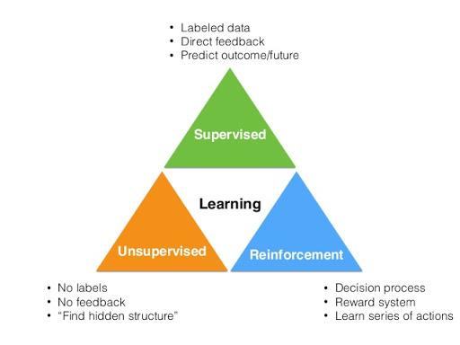
1. Introduction
Notes:
Then, Let’s talk about Introduction of this chapter.
what is supervised learning?
As i hope, you guys know about it already. There are three types of learning mechanism in ML.
These are Supervised Learning, Unsupervised Learning, and Reinforcement Learning.
One of them is Supervised Learning that there has actual result value for prediction to minimize error between real value and predicted value.
another method is Supervised Learning what learns without labels unlike supervised learning. and the other is Reinforcement Learning what learns by ‘Reward’ when it take some actions.
In chapter 2, we will handle about Supervised Learning in overall manner without others.

Slide 4
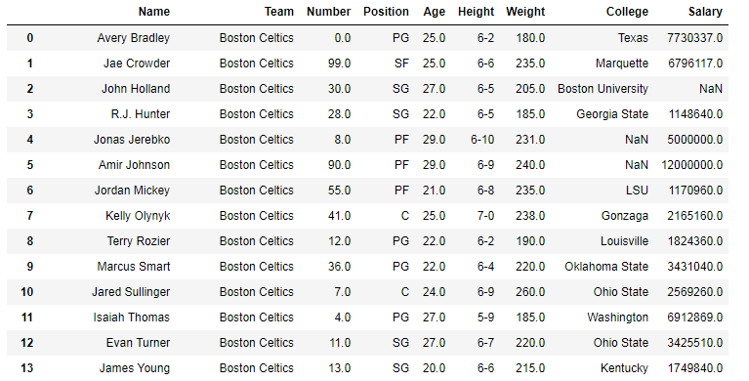
2. Variable Types and Terminology
Type of Variables
Qualitative Variable
Quantitative Variable
Notes:
Before talking about some representative models in Supervised Learning, Let’s look at basics around type and terminologies
Let me cover about data what becomes ingredient on training models.
And one more step to talk about data type before, how data looks like?
The most data what we gonna handle seems like matrix on the left side of slide.
It has rows and columns. row means individual point of data and column means variable of individual data point(row).
The reason why I take a image of data is this books has a perspective to see data as matrix.
Now, we could say about data type.
Data type is defined per column(variable) on matrix. what types of data are they?
There are two type of variable
Qualitative variable(i.e. Team name, Position, College)
Qualitative variable is no sequence each other and used like ‘class’. it says ‘categorical’ or ‘discrete’.
Sometimes qualitative variable represent to ‘dummy variable’ shape what spreads those column-wisely using binary value.
Ordered Categorical Variable
But if it has order between class it’s called Ordered Categorical variable compared with previous non-order categorical variable.
I think we couldn’t use dummy method cuz It would lose information about sequence.
Quantitative variable(i.e. Age, Height, Weight, Salary)
Quantitative variable has discrete and continuous value what doesn’t seem like Qualitative variable.

Slide 5
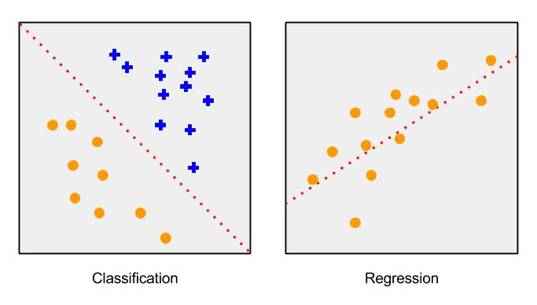
2. Variable Types and Terminology
Problem Definition by data type
Notes:
With definition of variable, take a handle about problem definition.
In supervised learning, there are two problem definition by target value’s variable type.
These are Classification and Regression problem.
Classification has ‘Qualitative target variable’ as target
Regression has ‘Quantitative target variable’ as target
But whether there is classification or regression problem, we could take similar approach via ‘function approximation’ like finding red line on images. So huge difference is not occurred by problem definition.

Slide 6
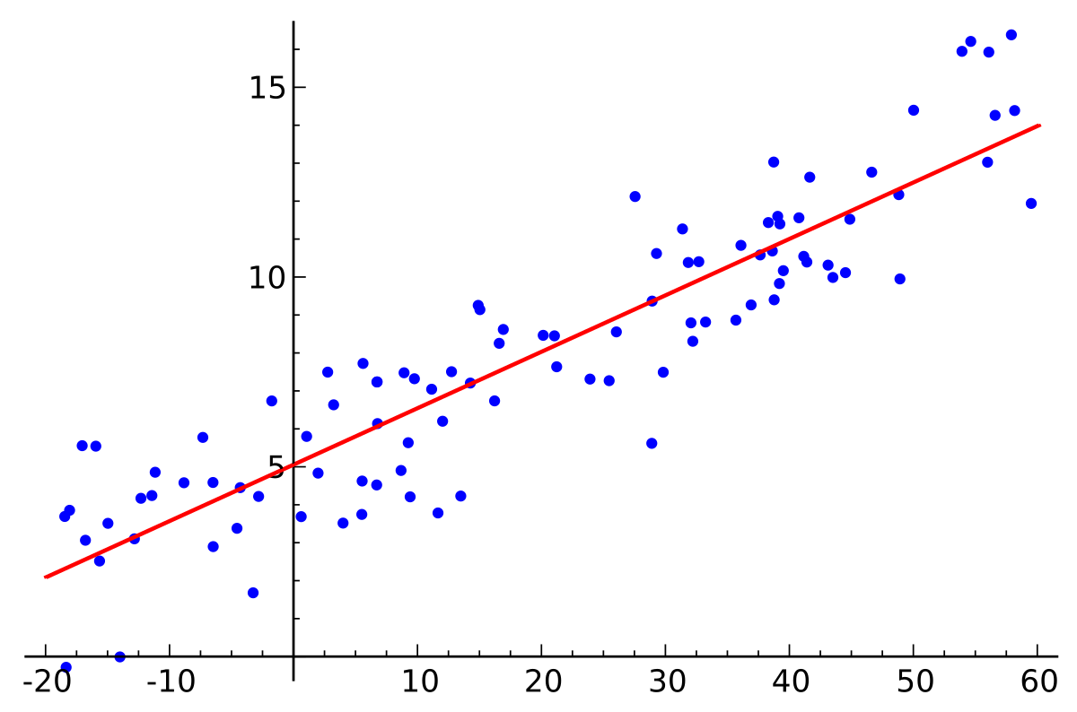

3. Two Simple Approaches to Prediction
linear model and least squares
Notes:
With few definitions, let’s look at the two representative model in this sub-chapter.
First is about Linear model.
Linear model is drawing regression line to the most representatively through data.
‘Regression’ means find a line that makes to minimize sum of residual along the data(not a 100% correct answer, just in simple).
And if we make equation using the linear line, it seems linear equation with sum of one intercept and many feature with weight.
So it could represent equation 2.1 and if we thought them as matrix, intercept could represent intercept multiply with identity matrix like equation 2.2.
And we call them betas after now.
For divide with actual and prediction value of Y, hat(^) used for it.
What is the objective of linear regression?
It is to find adequate ‘intercept and weights‘(beta hats) for drawing optimal regression line on dataset.
How to find them?
Among many methods, however, we could use least square method for it in next slide

Slide 7
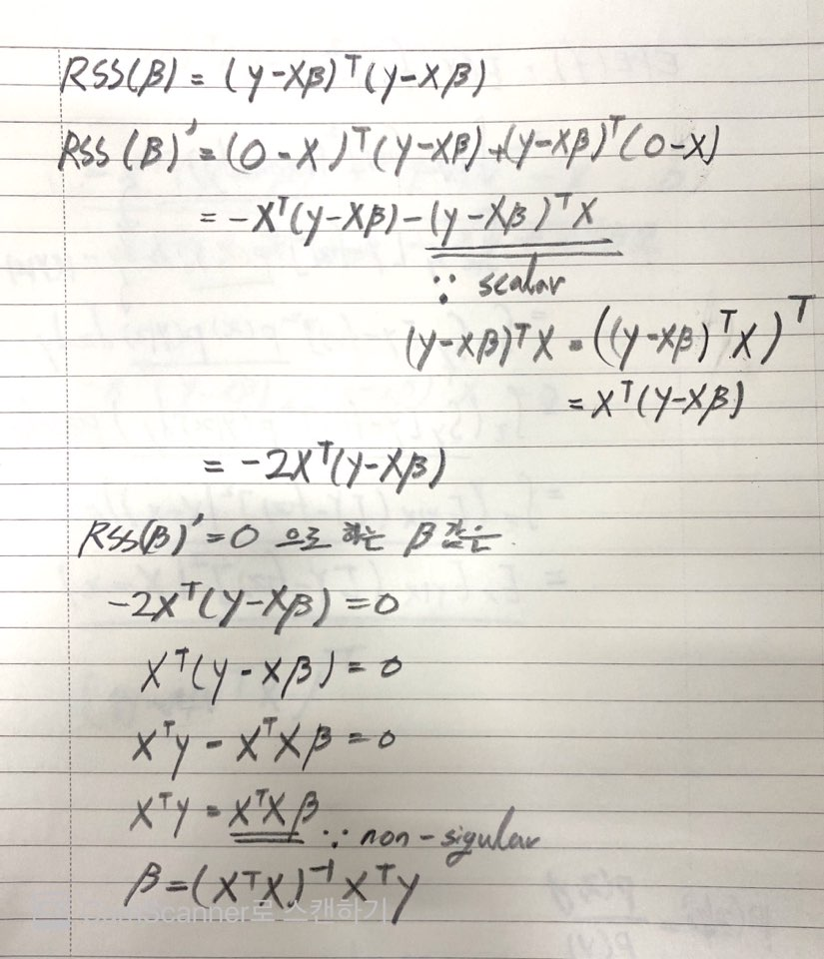


3. Two Simple Approaches to Prediction
linear model and least squares
The method of least squares is a standard approach in regression analysis to approximate the solution of overdetermined systems (sets of equations in which there are more equations than unknowns) by minimizing the sum of the squares of the residuals made in the results of every single equation. -Wikipedia-
Notes:
What is least square method?
Least square is one of approach for regression like our linear model as minimize sum of residual along the data through least square.
The equation of least square is taking a method sum of the squares of the residuals about single data point of real and prediction.
It represents as RSS in equation 2.3., to minimize 2.3. is main objective to find regression line in linear model.
‘yi’ is actual value of data ‘xi transpose beta’ is prediction value of data.
So, we need to find optimal beta value in RSS equation. and equation 2.3 be as positive polynomial equation of beta.
To one more step, equation 2.3. can be represented by 2.4 as matrix (like eq 2.2 and overall perspective of this book).
And then, for minimizing it, find the point of gradient to 0.
The derivative by beta is equation 2.5 become 0 for minimizing it.
Finally we could find equation 2.6 for optimal beta value.

Slide 8
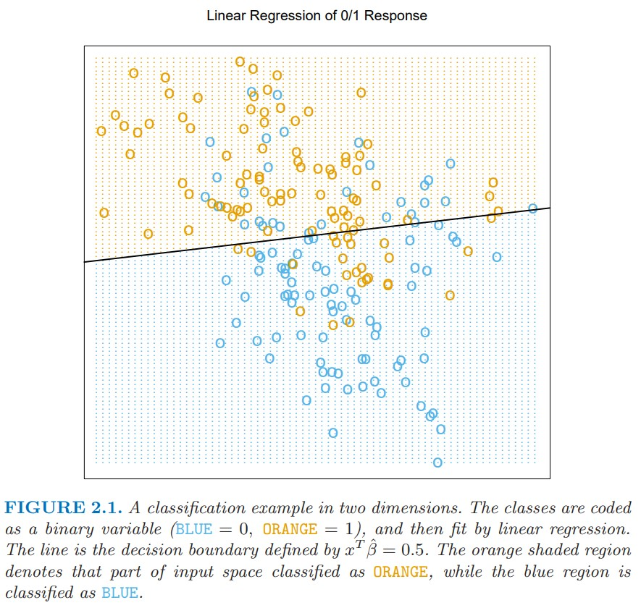
3. Two Simple Approaches to Prediction
linear model and least squares
Notes:
Here is one example of Linear Regression Classifier to make decision boundary via linear model.
Is it looked correct to classify?
There are some misclassified one unlike our intention.
How to reduce error?
It will be handled later part of this chapter..

Slide 9
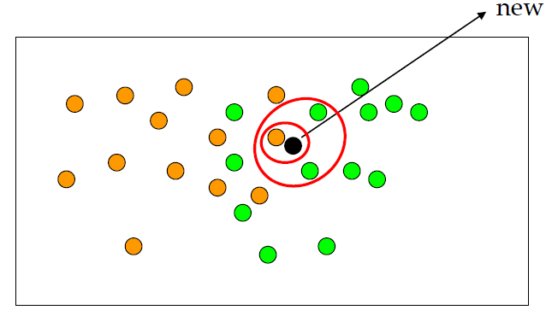

3. Two Simple Approaches to Prediction
k-nearest neighbor
Notes:
Nearest Neighbor method the way that reducing prediction value through training set’s observation.
Let’s look at the simple example of K-Nearest Neighbor on the left image of the slide.
It prepares data for dividing new points to two classes, orange and green.
In dividing new data black to two classes, declare the number of neighbors what are looking for near the black dot.
If I set k =1, the point will be orange because there is orange only when select neighbors by k parameter.
And If I set k=3, will be green because there are two greens than one orange when select neighbors by k parameter.
It needs to be presented mathematical way like equation on the right side of slide.
if i set orange =1 and green =0,
in k=1 the value of y hat will be 1/1 * (1) = 1
in k=3 the value of y hat will be ⅓ * (1+0+0) = ⅓
This is to make a value between 0 and 1 for showing it as mathematical way.
And if we set prob of classification between them fairly, 0.5 each other.
And let’s asks again to black dot. What color will be by number of neighbor?
if k=1, be orange cuz the y value more than 0.5
if k=3, be green cuz the y value more than 0.33

Slide 10
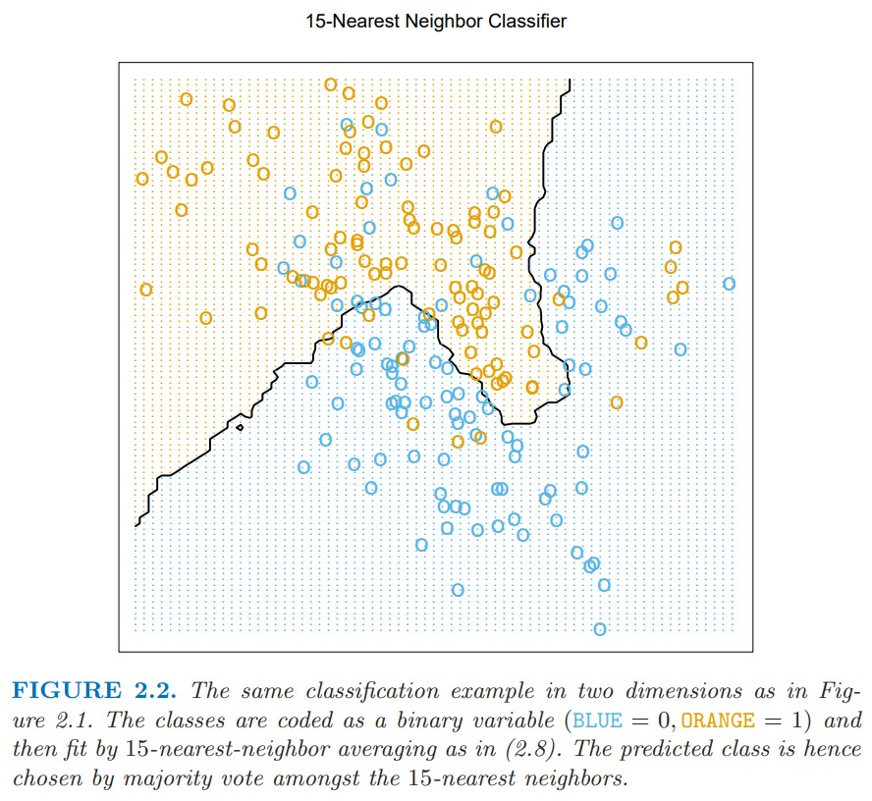
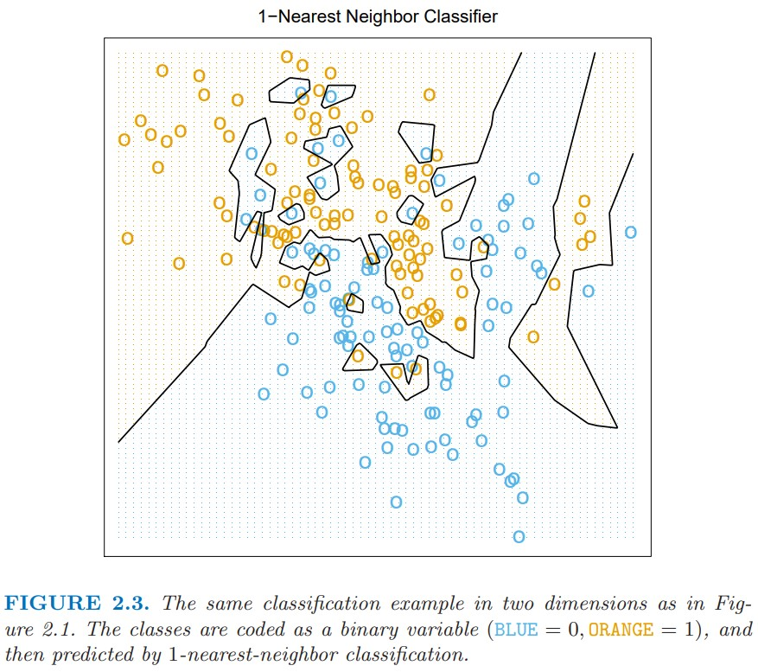
3. Two Simple Approaches to Prediction
k-nearest neighbor
Notes:
Beyond the calculation of one point, take a comparison between two nn model by number of neightbors (k=15 and k=1).
The decision boundary of k=15 on the left seems better than linear model.
And the decision boundary of k=1 on the right seems that there is no misclassification and detail dividing about two classes.
Then we could think, ‘choose k=1 always get correct answer without any misclassification!’. But That’s wrong.
There are some problems by selecting k=1, one of those is ‘over-fitting’ that will be described later as well.
Then. what is the optimal value of k?
= makes N/k more than parameter p(the number of features) of linear model.

Slide 11
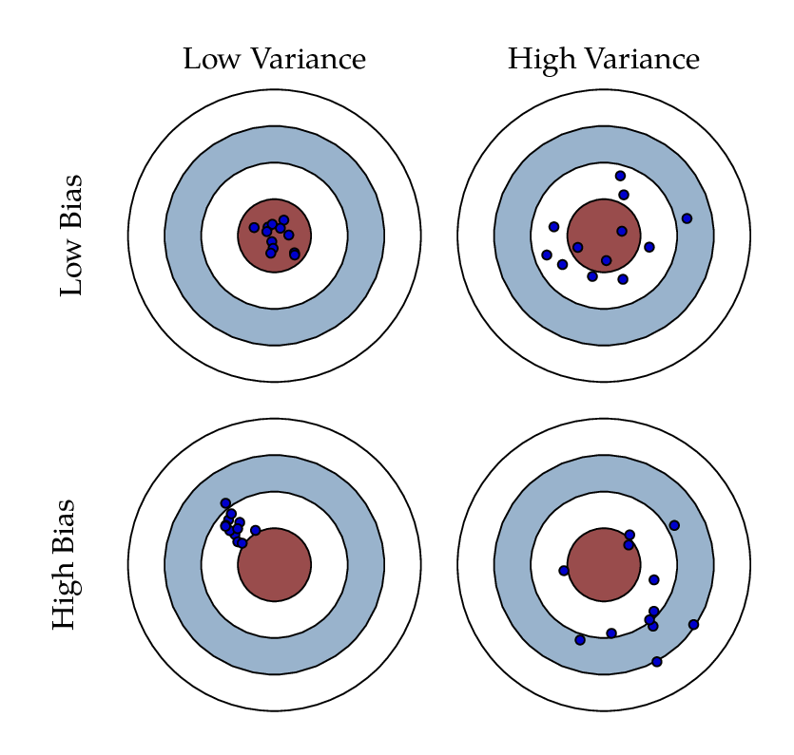
3. Two Simple Approaches to Prediction
comparison
Nearest Neighbor
Linear model
Notes:
When we compare or evaluate ML model, ‘Bias’ and ‘Variance’ is used for it.
The detail definition of them will be discussed later.
Then, we could divide those into this figure.
Linear Model has strong assumption optimal decision boundary seems linear.
So, model has high bias and Low variance.
Nearest Neighbor has any strong assumption unlike linear model and it can adopt any situation.
But, the specific point of decision boundary is unstable.
So, model has low bias and Low variance.

Slide 12
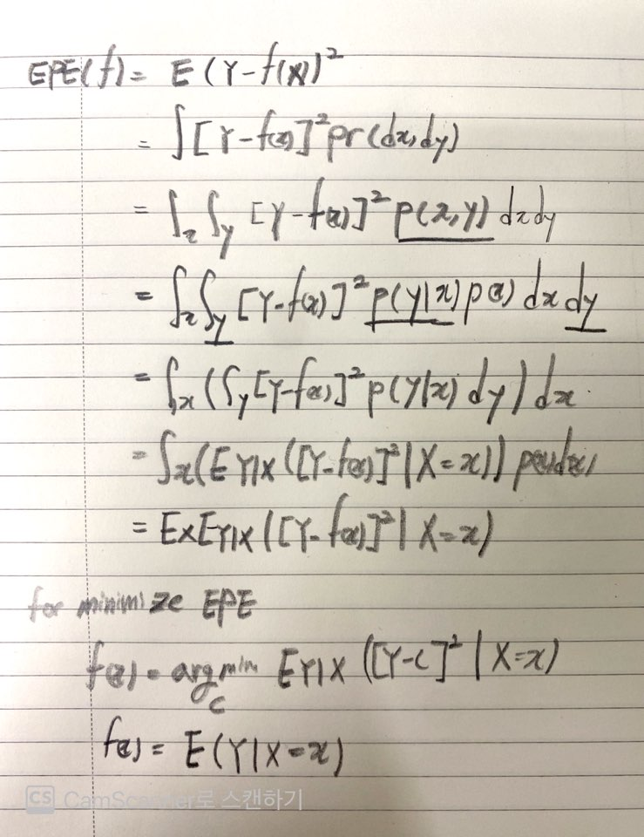

4. Statistical Decision Theory
Quantitative Variable
Notes:
We have seen two representative ML models.
Then, how we could think that the prediction model is right?
For decision making, we need to take some approaches.
‘Statistical Decision Theory’ is one of those approaches.
First, it’s about quantitative output.
We define X is random input vector what has p column and Y is also random real value vector.
The objective is find function f(X) for predicting Y given X vectors.
For statistical decision making, taking a expectation of prediction errors it’s called EPE.
By representing prediction error, squared error loss is taken and called L2 loss.
EPE with squared error loss seems like equation 2.9 to 2.11.
In the way to develop equation to 2.10 from 2.9, it converts as probability density function.
And because our objective is minimizing EPE in overall f(x), it could be represented like equation 2.12.
Finally, expectation of f(x) can be derived equation 2.13 by some processes like the right side of slide.

Slide 13

4. Statistical Decision Theory
NN and Linear Regression
Notes:
The prediction value of Nearest Neighbor can be developed like equation 2.14.
Because the result is made that summation of neighbor’s value and division by number of neighbors.
And there are two approximation for defining like eq 2.14
expectation is approximated by averaging over sample data;
conditioning at a point is relaxed to conditioning on some region “close” to target point.
In nearest neighbor, the bigger N value makes there are many neighbors specific x point and the bigger k value and average value will be stabilized.
So, eq 2.14 can be seem like 2.13
In Linear model, if we assume f(x) like eq. 2.15, we could find optimal beta value such as eq 2.6 replacing the expectation by average over training data.
And if it was represented as Matrix way, equation 2.16 is drived.
Both NN and Linear Regression replace Expectation to Average by approximation. but they have different model assumptions.
Least Square: function will be globally linear function
Nearest Neighbor: locally constant function

Slide 14

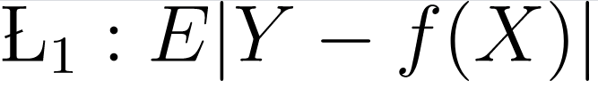

4. Statistical Decision Theory
Further thinkings
Notes:
rigid linear model
Equation 2.1. is origin linear model what we said before.
Do you guys think equation 2.1 is enough to predict optimal target function?
Some constraints(restriction) are needed for misclassification cases in Figure 2.1
Function fj is the function contained some rigid restriction such as additive constraints in this textbook
The reason why function has constraint is for granting flexibility what resolve misclassification error and high dimensionality problem in later chapter.
alternative of squared error loss function
And, do you remember Squared Error Loss function before?
Or how about using Absolute Value for Loss function instead of Squared Error Loss.
If we use absolute value as L1 loss, the result of prediction function will be median value around all x values like equation 2.18..
But, author said L2 would be prefer than L1.
There are some reasons why.
L2 loss is more robust than L1 when it encounter with outlier value because it used absolute value than squared.
L1 has discontinue property when L1 value being 0 due to derivative.

Slide 15
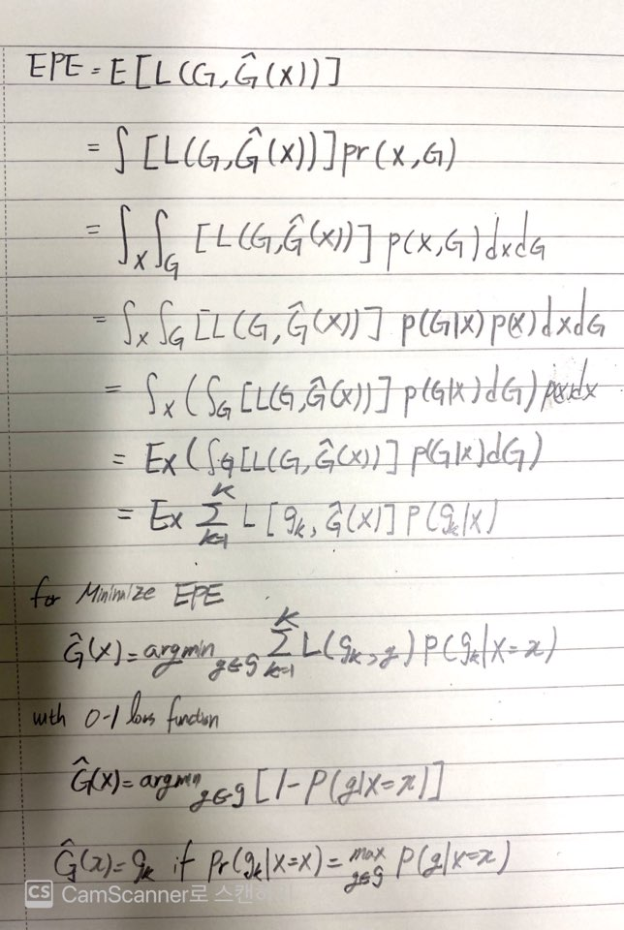


4. Statistical Decision Theory
Categorical Variable
Notes:
Now we could expand our thinking for multi-classification.
Loss function L for multi-classification has K rows and columns what has 0 values for diagonal and nonnegative value elsewhere.
And L(k,l) means the cost spends when class k specify I instead of actual value.

Slide 16
5. Local Methods in High Dimensions
Curse of Dimensionality
The curse of dimensionality refers to various phenomena that arise when analyzing and organizing data in high-dimensional spaces that do not occur in low-dimensional settings such as the three-dimensional physical space of everyday experience.
Notes:
Until the slide before, the example for explanation will be simple situation there are one or two variables(p) in two representative model.
Like the book’s saying in nearest neighbor, for getting good prediction result, large data samples and high number of neighbors is needed during prediction.
Is it available in complex case like there are huge number of columns on data also?
The more columns are on dataset, the more dimensional space are increased. it’s called being high dimensional space.
The result is that it’s not when high dimensional space like in nearest neighbor.
It’s one of the curse of dimensionality symptoms.
Now, we will talk about the symptoms in High Dimension dataset.

Slide 17
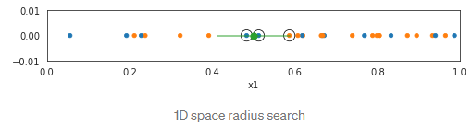
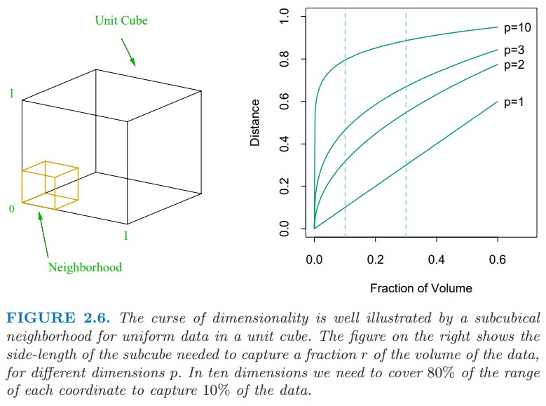
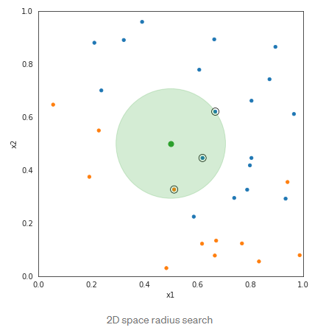
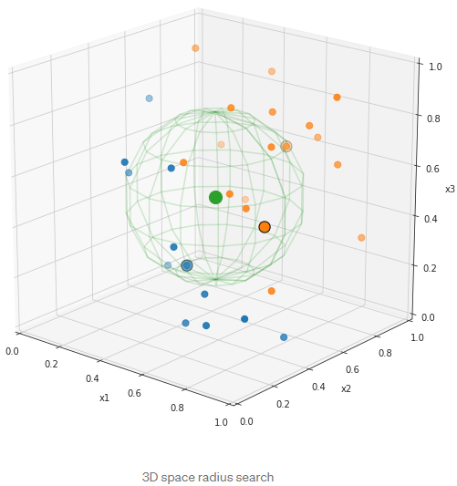
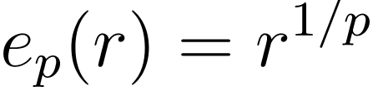
5. Local Methods in High Dimensions
1. Distance among neighbors
r=0.01 => 63%
r=0.1 => 80%
Notes:
The first symptoms of high dimensionality is increasing distance among neighbor.
Let’s make a dataset nearest neighbor, input, are uniformly distributed like left image as p-dimensional cube.
And the action to capture fraction r of observation also would be hypercubical neighborhood.
The equation of expected distance length between neighbor is ep(r) = r^{1/p}.
If we want to get 1% of data to local average must cover 63% and 10% need to cover 80% of input.
So neighbor could not say ‘local’ because the distance is going to big when parameter p becomes higher like the right images .
Reference(in English)
https://towardsdatascience.com/k-nearest-neighbors-and-the-curse-of-dimensionality-7d64634015d9

Slide 18


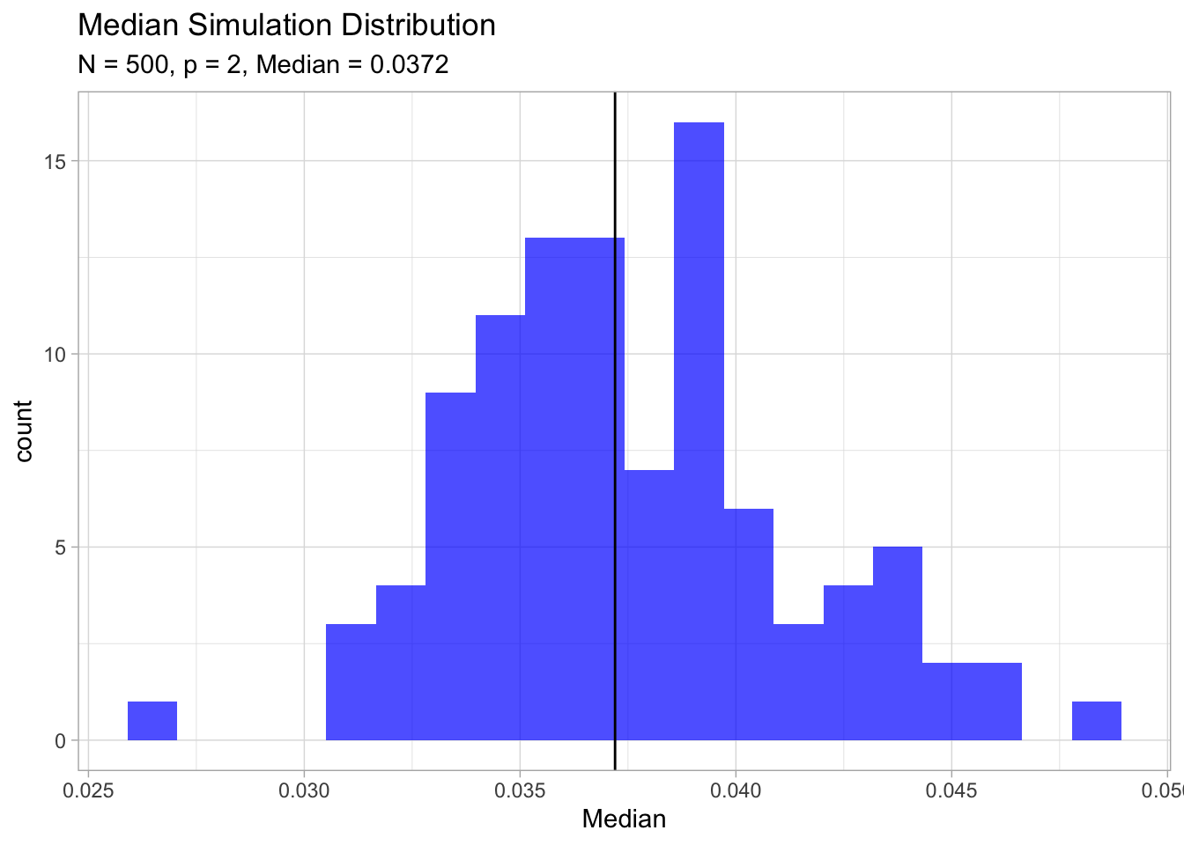
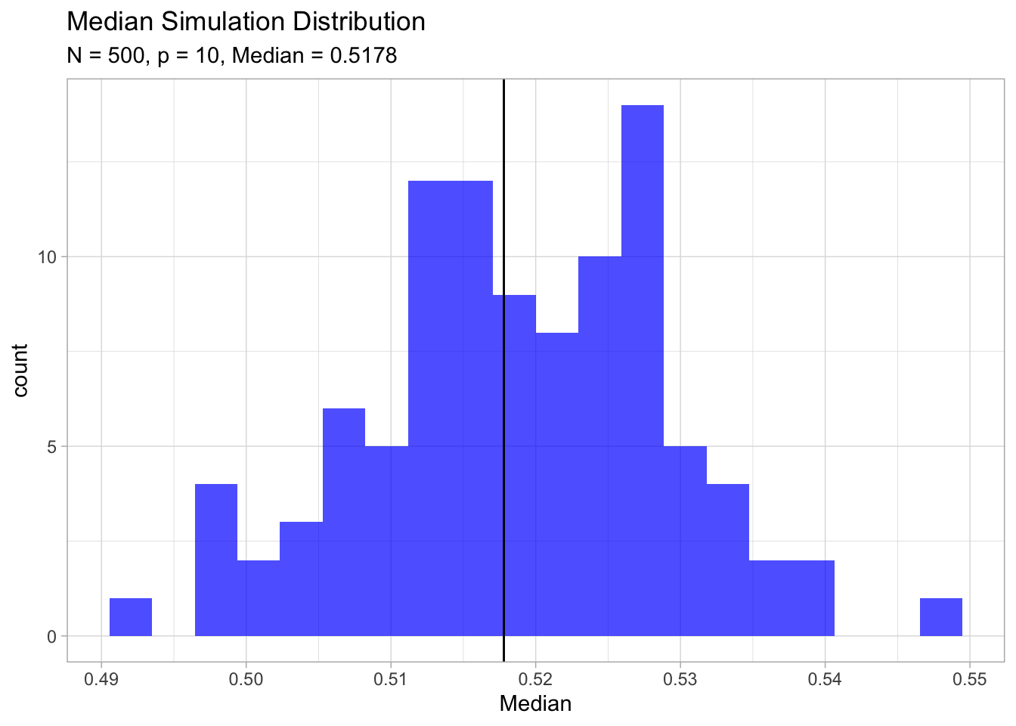

5. Local Methods in High Dimensions
2. Be close to an edge of sample
3. Diminishing sampling density
N1=100, dimension=1; sample size=100;
for same proportion in 10 dimension,
amount of samples above is needed
Notes:
There are other symptoms more.
Second one is data samples move to the edge by increasing the distance with target data point.
We keep thinking about p-dimensional unit ball centered at the origin.
The equation 2.24 means the median distance from origin data point to neighbor.
If N=500, p=10 then d(p,N) = 0.52.
It says more than half of data near to boundary from origin data point.
If we simulate it, we could distribution below.
Why is it a problem for prediction?
Prediction will be much more difficult near the edge of training sample (estimating point extrapolate vs interpolate).
Reference(in English)
https://stats.stackexchange.com/questions/206295/curse-of-dimensionality-why-is-it-a-problem-that-most-points-are-near-the-edge
https://juanitorduz.github.io/exploring-the-curse-of-dimensionality-part-ii./
The last symptom is about ‘Sampling Density’.
it will be changed by size of dimension p and It’s equation N^{1/p}
if p=1, and its number of sample 100.
And let’s compare it with high dimensional space p=10.
For same density, N_10 = 100^10 data is needed!.
In high dimensional space, we need much more data be trained.

Slide 19
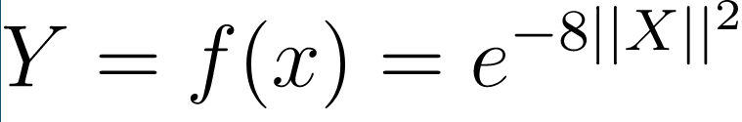
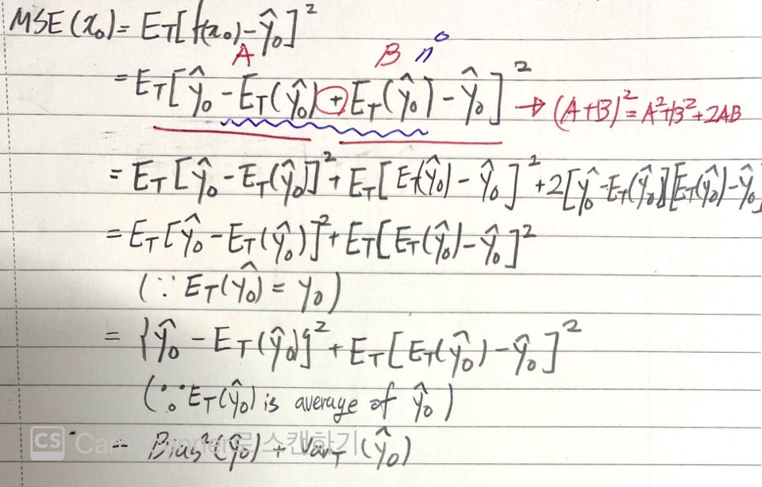
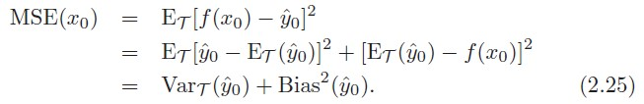
5. Local Methods in High Dimensions
About Bias and Variance
Bias: how much close samples average result with answer
low - good prediction via repeats
high - not good prediction despite to do many repeats
Variance: difference between samples average and one sample
low - constant approximation value by changes of sample
high - volatile approximation value by changes of sample
Notes:
Beyond the high dimension symptoms, Let me talk about Bias and Variance under the EPE equation for overcoming the curse.
The example space is defined that there are 1000 data points xi uniformly on [-1,1]^p and Y = f(X) = e −8||X||.
And to get MSE value in simple way, it uses 1-nearest-neighbor, and think about x0 point only.
How to get MSE value at x0 point via EPE of Square Error btw optimal function f(x0) and prediction value y hat 0 like top of eq 2.25.
For doing that, we need to do some trials to predict using different data samples(y0 hats) like getting sample using another data samples and average them for estimating MSE.
The symbol what I’m saying now is Et(y hat 0) means Expectation of y hat 0 via some datasets.
Why I say average of different data samples in a sudden?
There are few blue dots when I say model comparison in slide 11.
By taking samples with different training data we could measure bias and variance of our prediction function compared with target function.
Let’s develop equation 2.25 and the detail development of it is right side of slide.
In the development process of equation, Adding addition and subtraction of Et(y hat 0) itself on top of eq 2.25.
There is second line of picture.
And then substitution left red line as A and right red line as B.
It will be square on sum of two variables, A and B.
According to another equations below, finally we could get ‘\{\hat{y_0}-E_t(\hat{y_0})\}^2+E_t[E_t(\hat{y_0})-\hat{y_0}]^2’, the second line from the bottom.
The left side of it be as Bias and the right side of if be as Variance using words what I commented in previous slides.
Then, what is bias and variance?
Bias: how much close samples average result with answer
low - good prediction via repeats
high - not good prediction despite to do many repeats
Variance: difference between samples average and one sample
low - constant approximation value by changes of sample
high- volatile approximation value by changes of sample
So, we decompose bias and variance using Expectation of Loss function using example.
It’s called Bias-Variance Decomposition and two concepts have adopted to check the degree training of ML model.
Reference(in Korean)
https://ratsgo.github.io/machine%20learning/2017/05/19/biasvar/
https://www.youtube.com/watch?v=mZwszY3kQBg

Slide 20
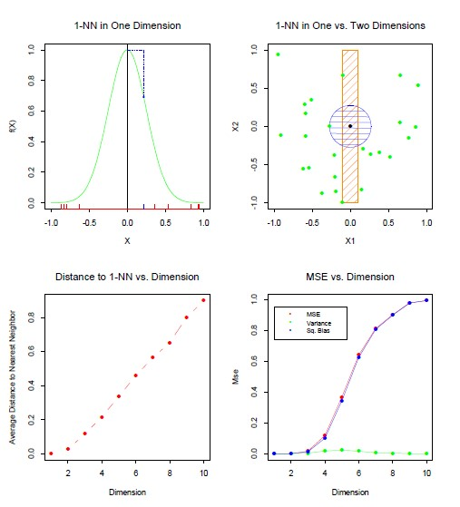
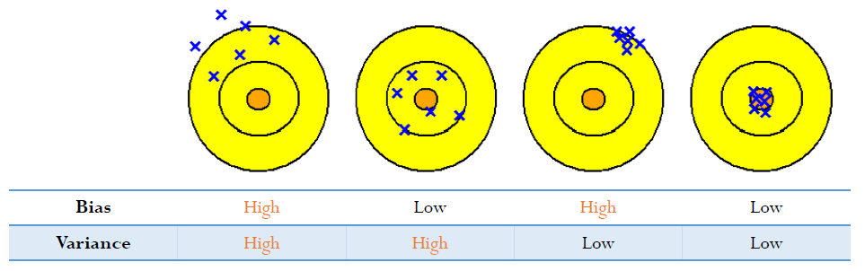
5. Local Methods in High Dimensions
About Bias and Variance
Notes:
Then let us turn back the result of example.
Like some symptoms of the curse before, the distance is getting far away with neighbor by increasing number of dimensions.
Due to that, a data point needs to predict will be far away from target point.
So, square of bias will be increased of MSE because the data points have become far away by increasing dimension.

Slide 21
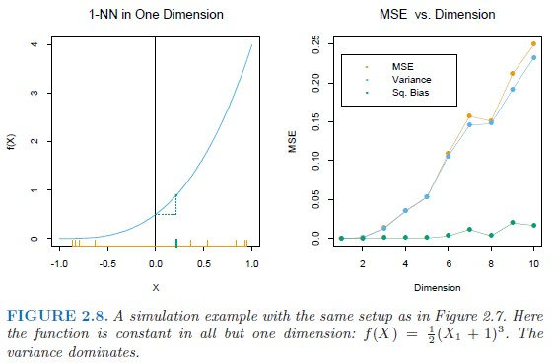
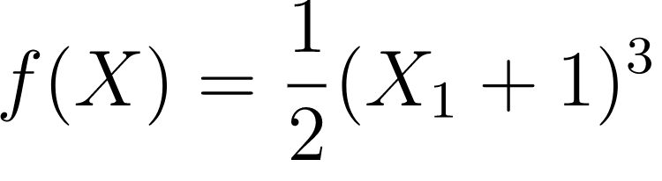
5. Local Methods in High Dimensions
About Bias and Variance
Notes:
If function f(x) become more complex than first example, f(x) be cubic equation than previous linear one.
The function what it’s more complex variance dominates in MSE unlike previous function.
I think the reason why it says about Bias and Variance by function(Model) Complexity is for showing the changes of those by complexity like Bias-Variance Trade-off problem. by handling simple example of 1-nn example.
Reference(in English)
https://stats.stackexchange.com/questions/144245/how-can-increasing-the-dimension-increase-the-variance-without-increasing-the-bi

Slide 22
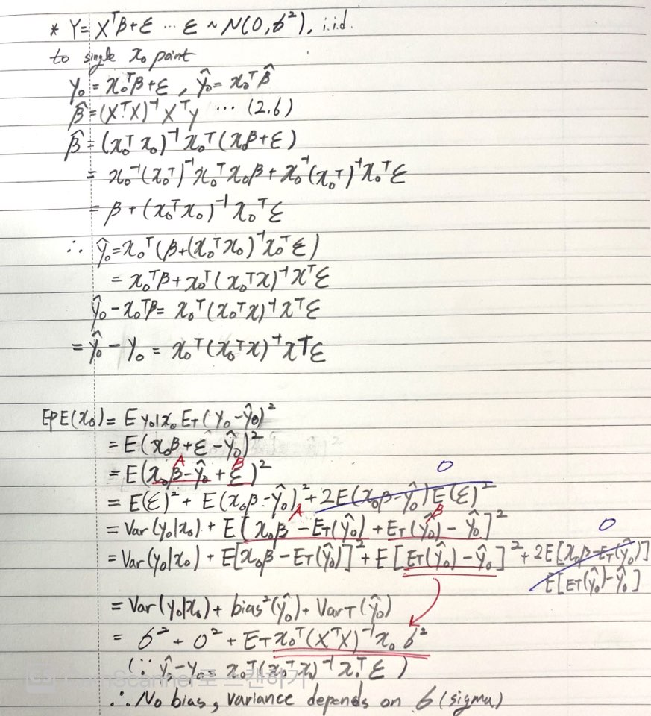

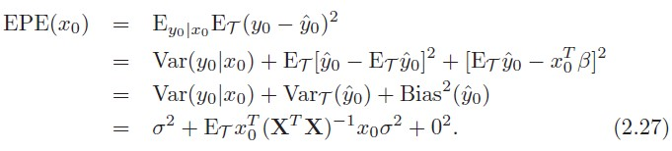
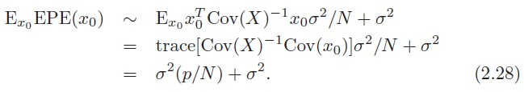
5. Local Methods in High Dimensions
Overcome the Curse in Linear model
Notes:
For handling to overcome the curse, nn model replace with linear model like eq 2.26
In equation 2.26, there is epsilon variable for taking prediction error between actual and prediction value.
Through similar development process like nn-model, we could derive last equation that consist of prediction error sigma square, variance, and bias square. and the variance depends on x0.
Sigmar square occurred due to epsilon variable unlike equation 2.2.
Why epsilon is added? That’s why the reason what I said about further thinking for rigid linear model for better prediction (equation 2.17)
Epsilon is measurement error as parameter for useful approximation to the truth.
So, we need something to be close the truth that’s error epsilon.
It’s linear model with additive error.
And if we take more assumption on the equation 2.27.
These are N is large and T were selected at random, and Expectation of X is 0.
Then XT X → NCov(X). It will be derived like equation 2.28.
According to eq 2.28, EPE increased linearly as function of p, with slope sigma square divide N.
If N is large sigma square is small, effect of p value is negligible.
Thus, linear model could handle to effect of increasing dimensionality via some restrictions like above.

Slide 23
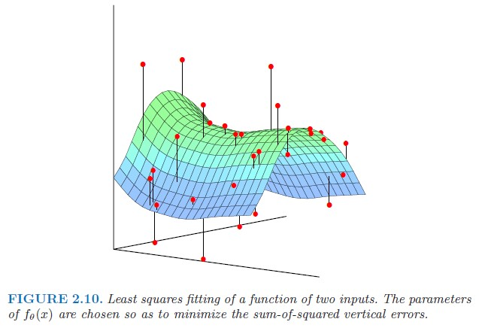



6. Statistical Models, Supervised Learning and Function Approximation
Notes:
Supervised Learning and Function Approximation
Using Statistical model such as equation 2.26, there are two similar words about training perspective.
First, it’s called Supervised Learning by ML perspective.
In supervised learning, we would feed training data passed by predicting function f via learning algorithm.
During the training, output will be generated f hat x per training data point.
And prediction value and actual value utilize to approximate optimal f function via differences between them.
===============================================================================================
Function Approximation
The goal of Function Approximation is obtain a useful approximation to target function f(x) for all x, given the representations in T(Training dataset p-dimensional Real Value Matrix R^p). the book’s main approach is looking at Supervised Learning as Function Approximation.
we could represent linear model what have seen above like equation 2.30 as theta is beta and hk is transformation function of input vector x. if we without hk it seems same with eq 2.2.
if dimension value p is 2, the graph of f theta looks like figure 2.10. and residual btw actual and prediction is black bar from red point to optimal graph. optimal function f theta also could be derived RSS like eq.2.32.

Slide 24

6. Statistical Models, Supervised Learning and Function Approximation
Maximum Likelihood Estimation
Notes:
However, RSS is not the only criterion to approximate function.
Another general principle is maximum likelihood estimation.
It’s equation is 2.33. summation of density via observed sample’s value yi with log.
The principle of maximum likelihood assume that the most reasonable values for theta are the those for which the probability of the observed sample is largest.
And MLE problem is defined like 2.34 has same objective RSS method.
Then, how MLE works?? let’s talk about next slide

Slide 25
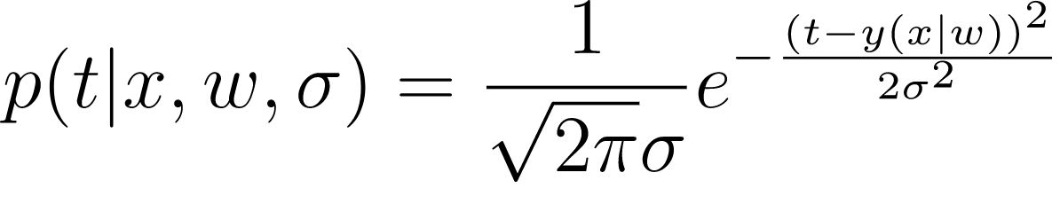
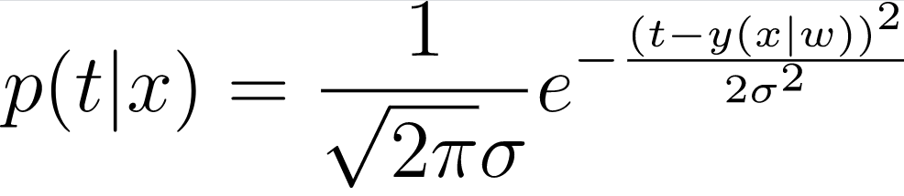
6. Statistical Models, Supervised Learning and Function Approximation
Maximum Likelihood Estimation
There is a problem to predict weight using height.
=> X: height, Y: weight, w: parameters to describe relationship between them.
To functional representation,
t[weight] = y(x|w) … conditional probability x on parameter w.
but, it needs error variable(epsilon) like linear model to approximate target and prediction value.
and w contains bias and coefficient of linear model.
according to above, weight t can be represented gaussian distribution.
t ~ N(y(x|w), σ2),
due to that w and sigma are the parameter what needs to be approximate,
Notes:
Let me talk about simple question how MLE works.
let’s see this problem as probability distribution problem.

Slide 26
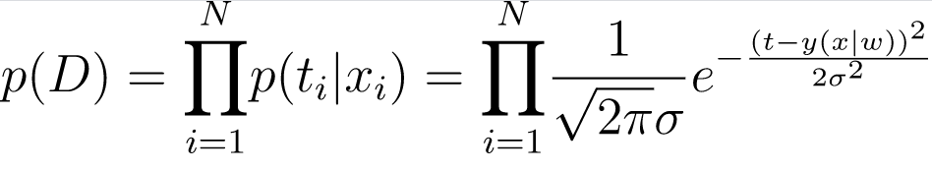
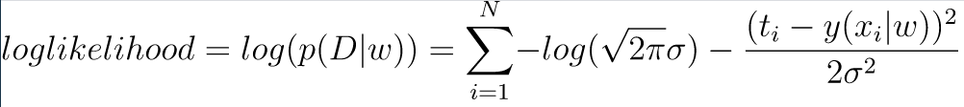
6. Statistical Models, Supervised Learning and Function Approximation
Maximum Likelihood Estimation
And represent the probability of all data points D(all datapoint xi),
By above equation, p(D) will be changed by w. So, p(D) could be replaced with p(D|w).
Finally, the model that needs to be predicted is maximizing p(D|w) at all of the data points.
It’s called as ‘Maximum Likelihood Estimation’.
The reason why take log at ‘Maximum Likelihood Estimation’ is for convenience at calculation
(for converting multiplication to summation using log’s property)
Notes:
I think this is the why it said statistical model as joint distribution probability in chapter 2.6.1.

Slide 27
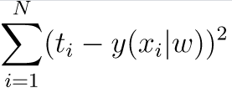
6. Statistical Models, Supervised Learning and Function Approximation
RSS and MLE
People have said like “Maximizing MLE is equal action with Minimizing Squared Loss”.
Look at the last equation we said.
Remove constants(pi, sigma) what doesn’t contribute to maximize likelihood.
Then, we could get squared loss between target value[ti] and prediction value[y(xi|w)]
So, We could say Maximizing MLE is same way to Minimizing squared loss.

Slide 28
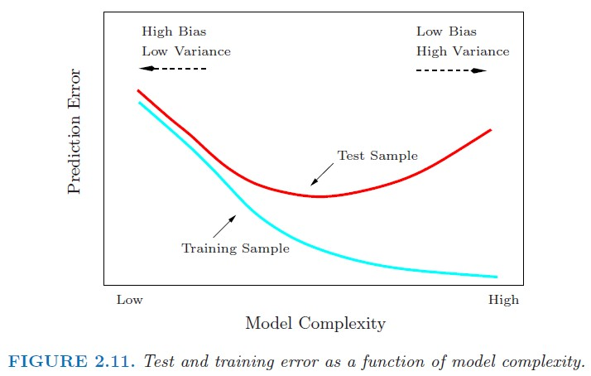
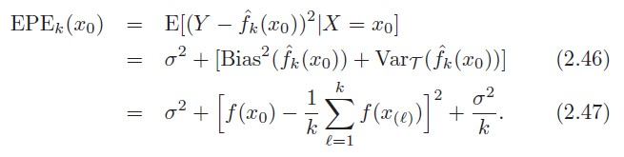
9. Model Selection and Bias-Variance Trade off
Look at the EPE(x0) equation of k-NN model below,
It also could be decompose Bias and Variance above.
If k value increased,
Bias will be increased
Variance will be decreased.
Notes:
Lastly, let me talk about trade-off between bias and variance.
Occurring trade-off between those is two variables are dependent each other.
Take a look at EPE of k-nearest neighbor in equation 2.46 and 2.47.
The trade-off would be determined by k value.
When k value become bigger, bias becomes higher and variance becomes lower due to the equation 2.47.
Vice versa, bias becomes lower and variance becomes higher.
So, In ML problem, Trade-off case is inevitable problem and the problem what we should find optimal trade-off level.
The right image is General Trade-off diagram by model complexity.
If model complexity is low, the model has high bias and low variance.
For getting better prediction on training and test sample, Bias will be low and Variance will be high to the way of increasing model complexity.
But test sample’s prediction error curve increase from a point of middle of complexity.
If model go toward this way despite the increasing test sample’s prediction error, prediction is good for training sample only.
In training model training process the former is called ‘underfitted’ and latter is called ‘overfitted’.
So, we need to find optimal parameters of adopted model for problem solving in not underfit and overfit way.

